Slide 1
ISE 599 Project: News Analysis
Team: Three Bunnies
Team Member: Zhenghao Yu, Qiuyu Mei, Aihan Yang
Notes:
Hello everyone, this is team three bunnies and now we will talk about our project progress.
We are trying to do the news analysis.

Slide 2
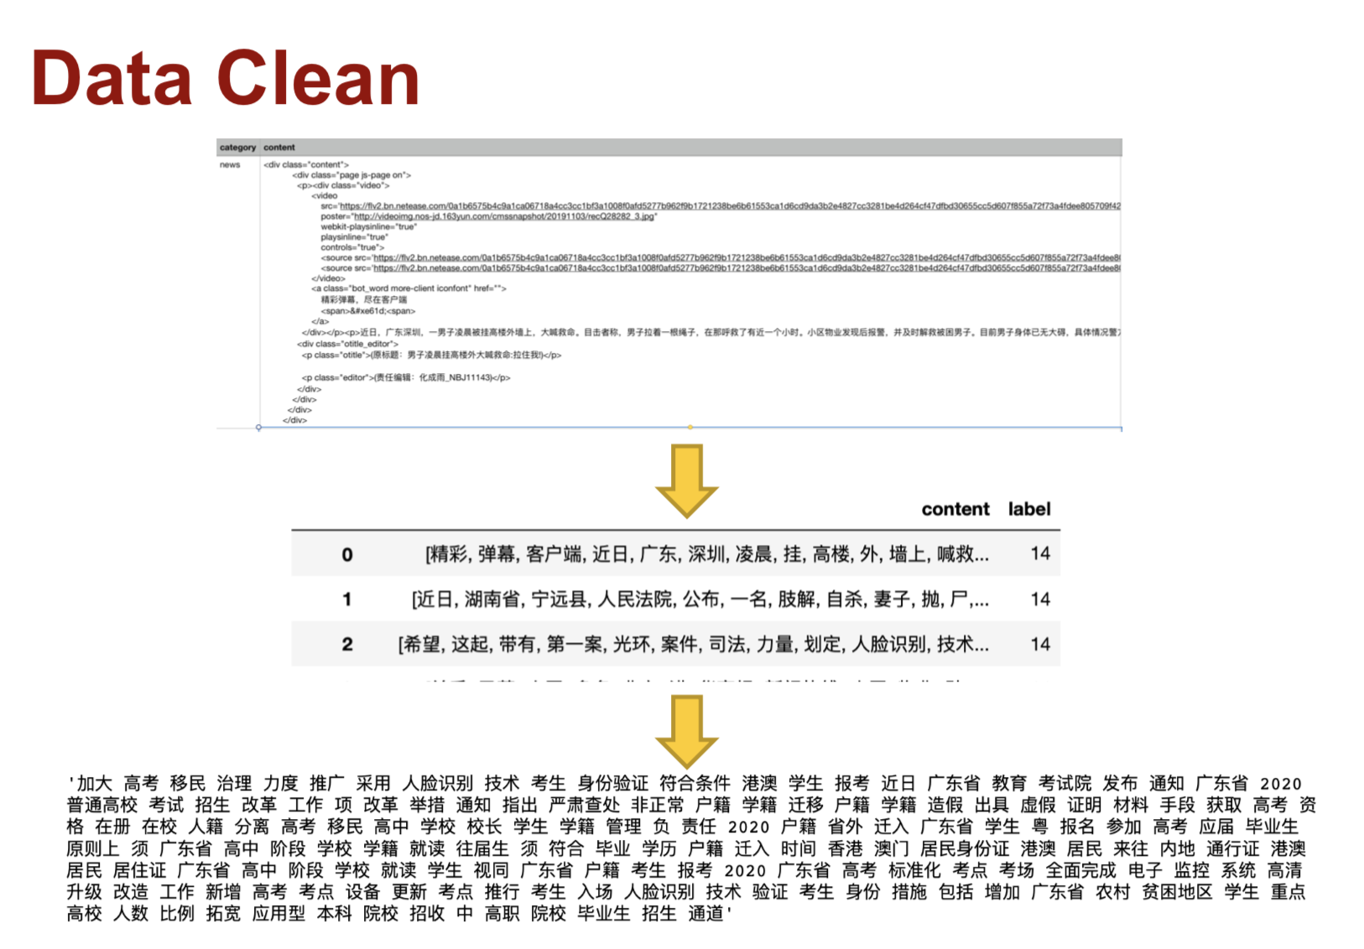
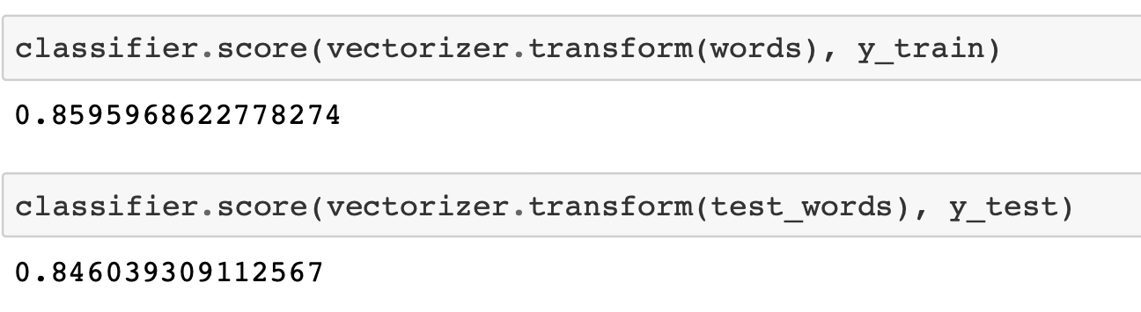
Review
Content
Data Clean
Classifier：
Naïve Bayes
Accuracy

Slide 3

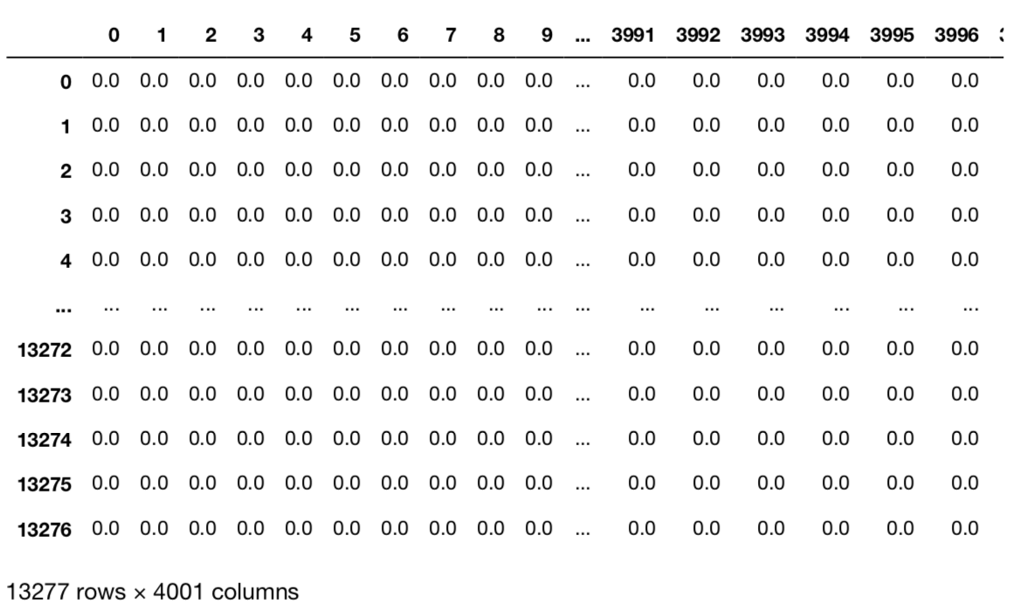
Review----Modeling and Testing

Slide 4
Review:
Content or Title
Title
Date
Source
Try more different Classifiers
✌️
✌️
✌️
✌️
😭
Notes:
For next step, we will try to use the title to predict the category just like the homework 4, and we will try if content is better or title is better or combined title and and content is better.
And we we know that date is important for the news. Like in some time period for example at June 7th and 8^{th which is} Chinese college entrance examination date. There maybe more news about education. Also we want to analysis the source.
And we will try to fit more classifiers to see which one is the best.
😭

Slide 5
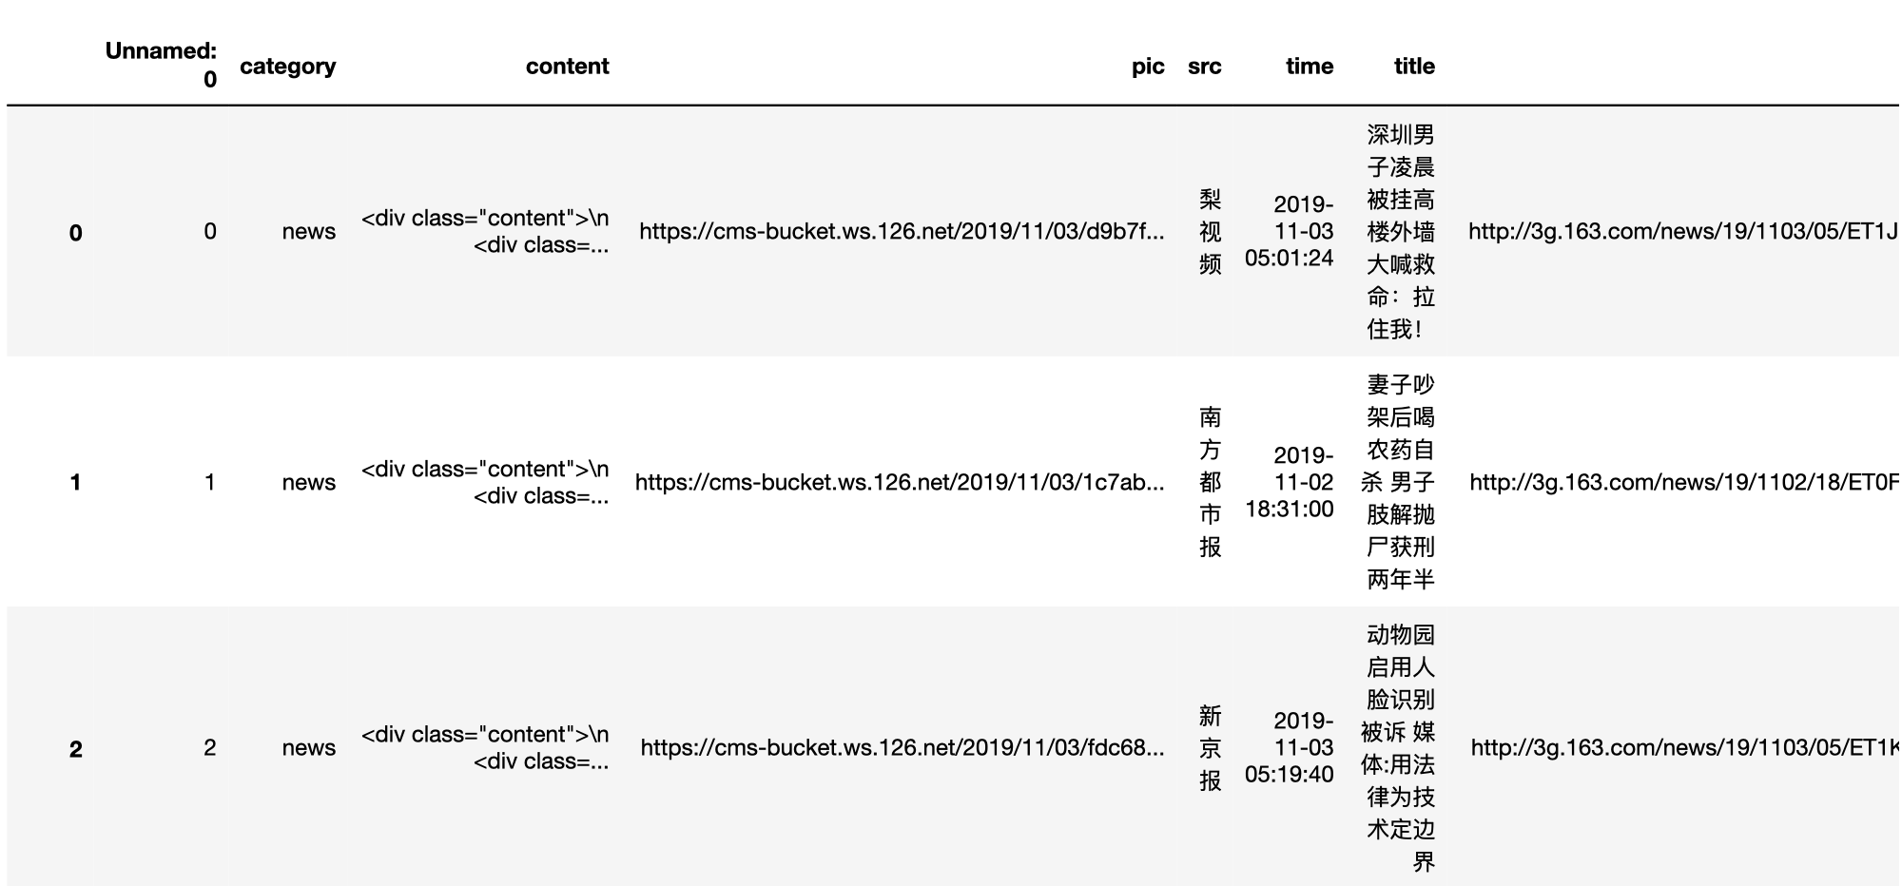
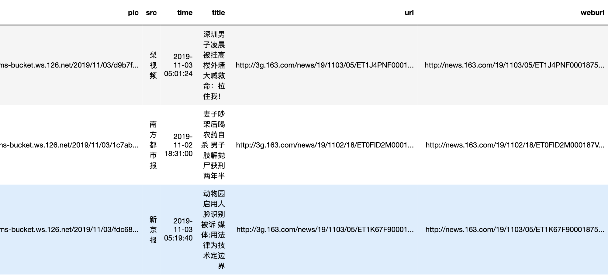
Data Input
Total: 14000
Notes:
And first we trying to use the news content to predict the news category.

Slide 6
Modeling and Testing
Bayes
Neural Net
Gradient Boosting Tree
Random Forest

Slide 7
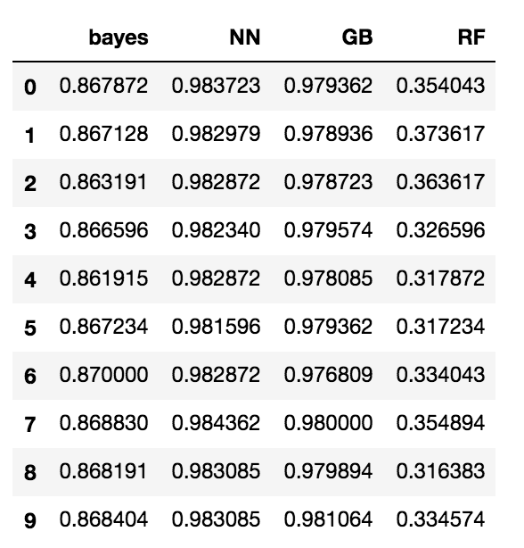
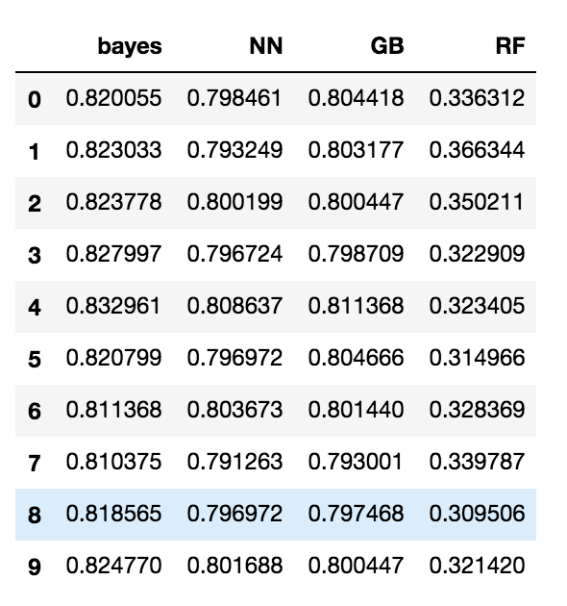
Modeling and Testing
Train
Test

Slide 8
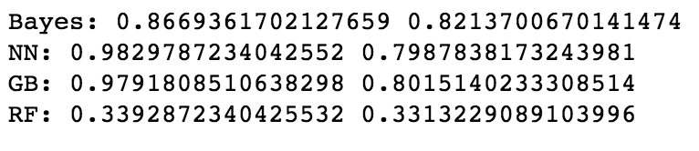
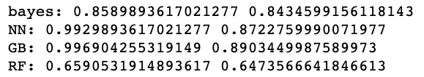
Modeling and Testing
Train
Test
Title
Content

Slide 9
Modeling and Testing
Best Model + Best feature
Content
Gradient Boosting tree
GB Test Accuracy = 0.8903

Slide 10
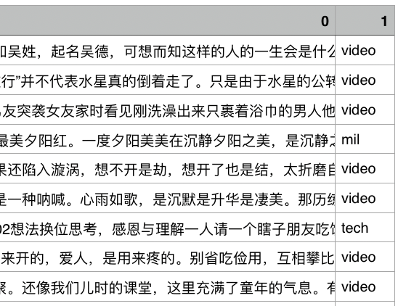
Predict

Slide 11
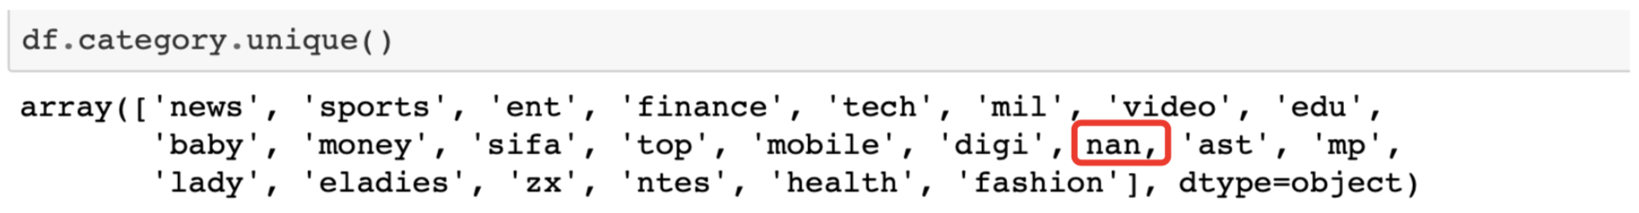
Predict
古人云：赐子千金，不如教子一艺；教子一艺，不如赐子好名。因此无论起名或改名，一定要慎之又慎，千万不可忽视。名与姓的关系十分密切，字形字义搭配必须合理。比如吴姓，起名吴德，可想而知这样的人的一生会是什么样子。胡姓，叫胡伟，他不胡作非为就是怪事。还有位叫王栓柱的（望拴住），结果是被判了无期徒刑，永远被拴住了。你看林彪的名字，林中出现的一只花斑猛虎，必伤人；本身彪字带有三撇，一定有严重的刑伤。有位女孩叫张雪，我推断她婚姻不顺，妇科不调，怕冷。事实上，结婚时间不长就离婚了，一直没有孩子。
The ancients said: give a child a thousand gold, not as good as teaching a child art; It is better to give a son a good name than to teach him an art. Therefore, no matter the name or renamed, must be careful, must not be ignored. The relation between name and surname is very close. For example, wu surname, named wu DE, you can imagine what such a person's life will be like. His name is hu wei. It's strange if he doesn't do something wrong. There was also a man named wang shuanzhu (wang shuanzhu), who was sentenced to life imprisonment and was chained forever. You see the name of Lin biao, a tiger in the woods, will hurt; Its biao word with three prime, there must be a serious injury. A girl named zhang xue, I concluded that her marriage is not good, gynecological tone, afraid of the cold. In fact, they divorced shortly after their marriage and never had children.

Slide 12
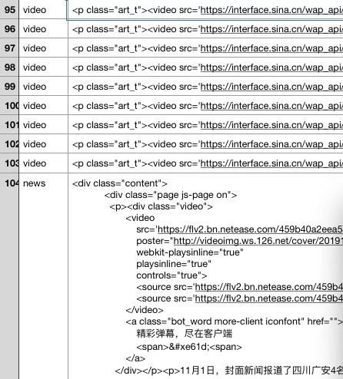
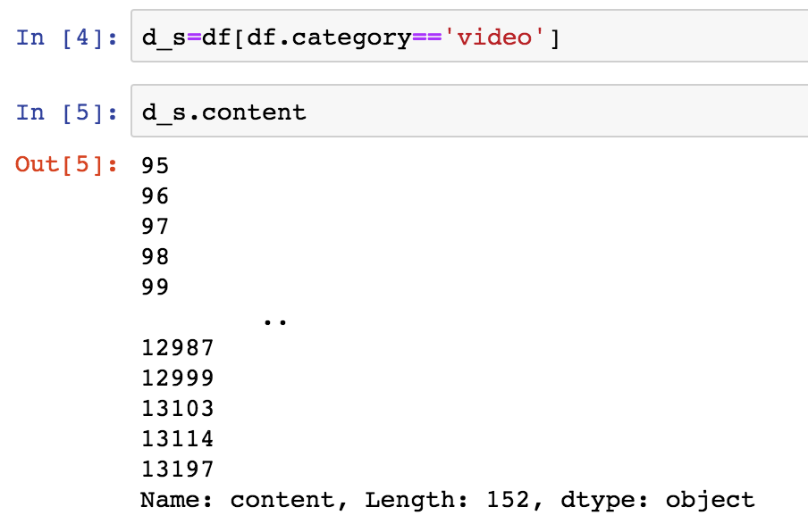
Predict

Slide 13
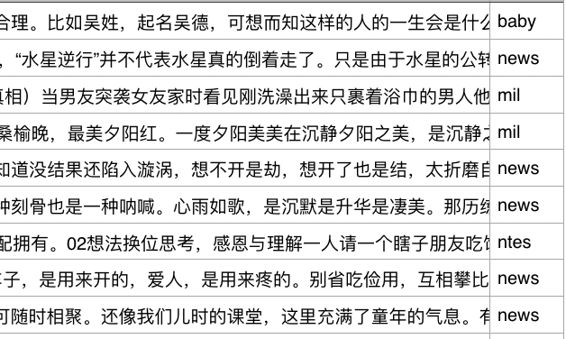
Predict

Slide 14
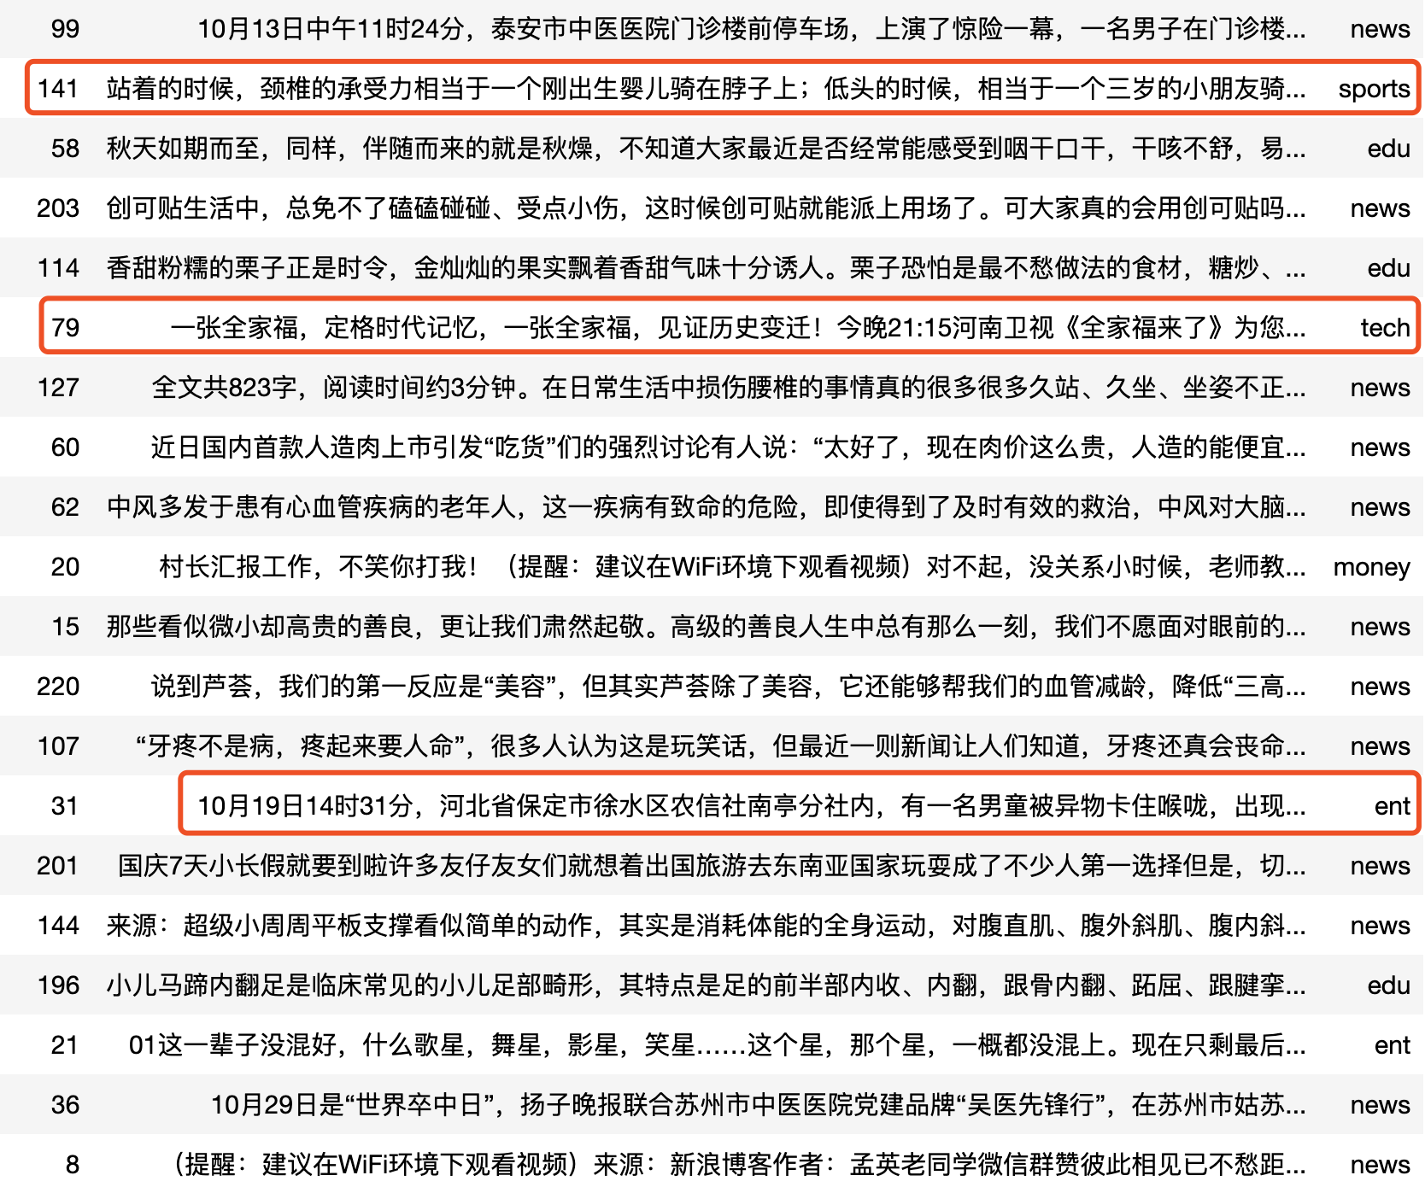
Analysis
200
A=17/20=85%
85%
~GB Test Accuracy = 0.8903
20

Slide 15
Sample Analysis
站着的时候，颈椎的承受力相当于一个刚出生婴儿骑在脖子上；低头的时候，相当于一个三岁的小朋友骑在脖子上；而更可怕的是长时间低头，相当于一个小胖墩骑在脖子上。长时间低头，颈椎的生理曲度就会发生明显的改变，令肌肉更加紧张，降低肌肉的稳定性，甚至让颈椎产生滑移，导致椎体和肩盘的退变，压迫神经，这样就会产生严重的颈椎病。
When standing, the cervical spine is equivalent to a newborn baby riding on the neck; when bowing, it is equivalent to a three-year-old child riding on the neck; and even more terrible is to bow for a long time, equivalent to a small fat pier Riding on the neck. Long time bowing, the physiological curvature of the cervical vertebra will change significantly, make the muscles more tense, reduce the stability of the muscles, and even cause the cervical spine to slip, leading to the degeneration of the vertebral body and the shoulder plate, compressing the nerves, this will Produces severe cervical spondylosis.
sports
baby
Notes:
Interestingly, there is a typical error in our prediction. In this example, standing and riding are some actions, so our model may classify this news as a sports category .However, based on our manual identification, it should belong to education.

Slide 16
Future And Prospects
News
video
not only Tf-idf
（提醒：建议在WiFi环境下观看视频）来源：新浪博客作者：孟英老同学微信群赞彼此相见已不愁距离，这就是网络的奇迹。如今又发挥了微信的特点，众人在群里可随时相聚。
Multi-label
Encode(not only Tf-idf)
(Reminder: It is recommended to watch the video in a WiFi environment) Source: Sina blog Author: Meng Ying old school meet each other like micro-channel group has no worries about the distance, this is the miracle of the network. Nowadays, the characteristics of WeChat are also played, and everyone can gather at any time in the group.
Advanced prediction method
Trade-off
Combined context to predict
between accuracy and model complexity

